Slide 1
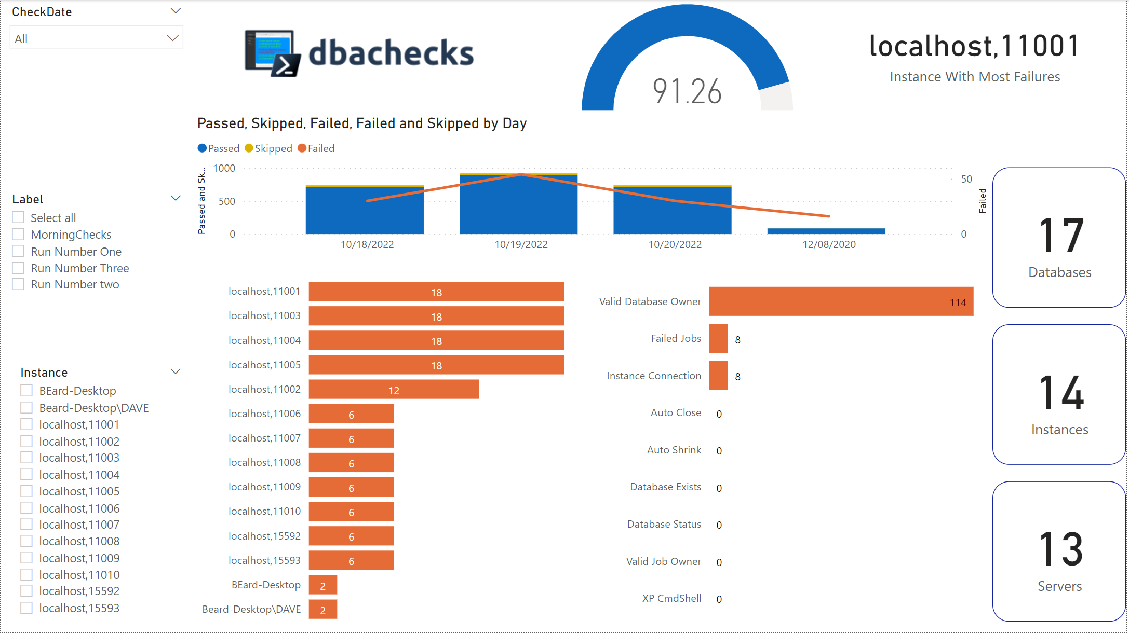
Introducing dbachecks v3
Introduction to latest version of dbachecks, a SQL Server configuration validation framework
Notes:
C

Slide 2

















Thank you to our sponsors

Slide 3



Introduction
Who we are
What dbachecks is
Why it matters
DBAs and infrastructure experts supporting the SQL Server community
An open-source PowerShell module of validation checks for SQL Server environments
Helps DBAs and infra experts validate and secure SQL Server environments
dbachecks is an invaluable open-source tool created by and for the SQL Server community to validate and secure database environments.
Notes:
R

Slide 4


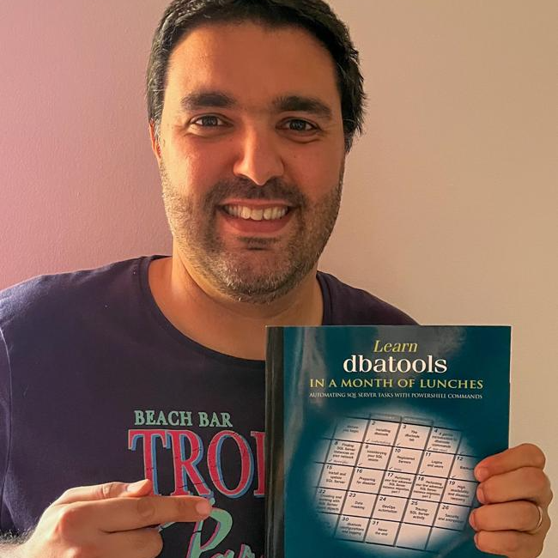
Who Did It?
Rob Sewell
Jess Pomfret
Claudio Silva
Notes:
J

Slide 5



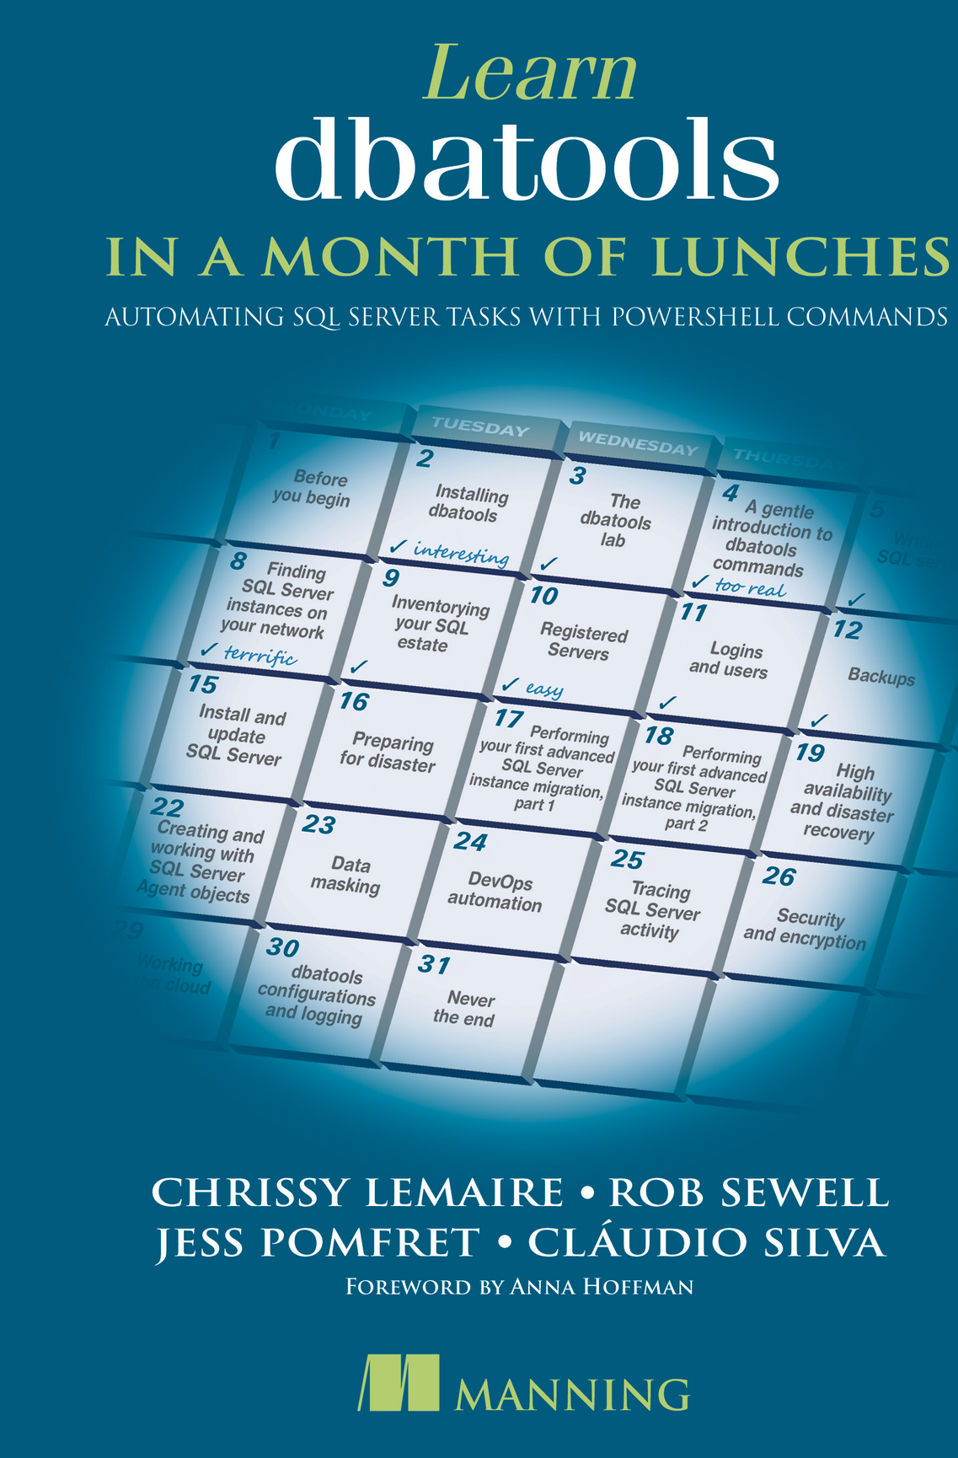


jpomfret7@gmail.com
Jess Pomfret
She/Her
I'm a data platform engineer with a passion for automation, proper football, and fitness. I enjoy contributing to open-source software and I'm a maintainer for dbatools.
DATA MASTERMINDS
Data Platform Engineer
DUAL MICROSOFT MVP
Cloud and Data Center Management
Data Platform
JESSPOMFRET.COM
Notes:
J

Slide 6



claudiosil100@gmail.com
Cláudio Silva
He/Him
I work as Data Platform Engineer doing a lot of query performance tuning and I'm a PowerShell lover who automates any process that needs to be done more than a couple of times
DATA MASTERMINDS
Data Platform Engineer
MICROSOFT MVP
Data Platform
CLAUDIOESSILVA.EU
Notes:
C

Slide 7



Rob Sewell
mrrobsewell@outlook.com
He/Him
I was a SQL Server DBA with a passion for Powershell, Azure, Automation, and SQL (PaaS geddit?) (And a sense of humour (and a habit for writing inside braces)). Now I just help other people with those (not the braces bit).
SEWELLS CONSULTING LTD
Beard Twizzler
DUAL MICROSOFT MVP
Data Platform
Cloud and Data Center Management
robsewell.com
Notes:
R

Slide 8

What Is dbachecks?
dbachecks is an open source PowerShell module for
validating the configuration of SQL Server instances using Pester.
Notes:
J

Slide 9

Evolution of dbachecks
2016
Initially, Rob created dbareports to validate and report on SQL estates
Notes:
R

Slide 10
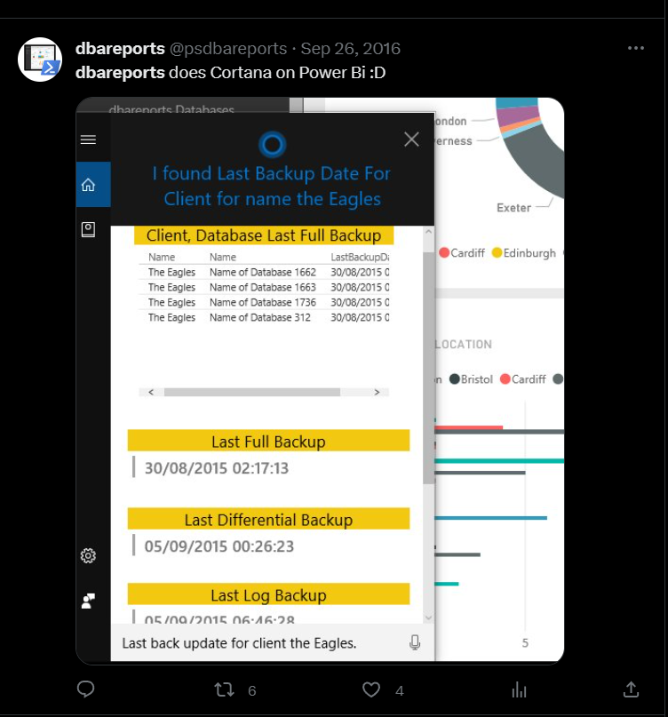
Evolution of dbachecks
2016
Initially, Rob created dbareports to validate and report on SQL estates
IT WAS SUPER COOL !!
Notes:
R

Slide 11
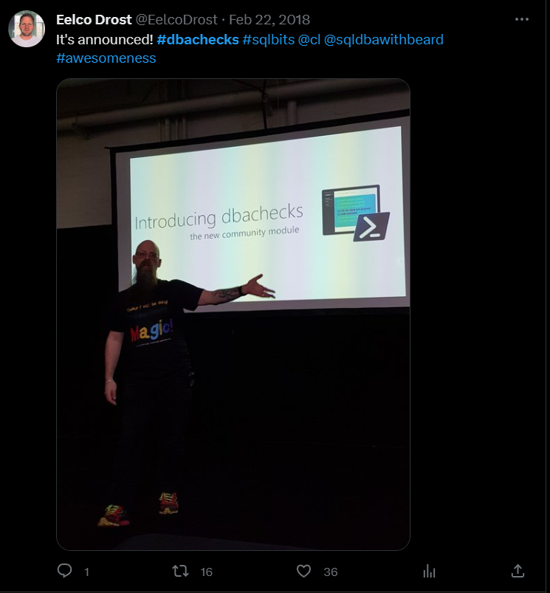



Evolution of dbachecks
2016
2022
Initially, Rob created dbareports to validate and report on SQL estates
dbachecks v3 redesigned framework and modularized checks.
2018
2020
dbachecks v1 released at SQLBits enabling configurable Pester checks using dbatools
dbachecks v2 added more validation checks and improved documentation.
Notes:
R

Slide 12
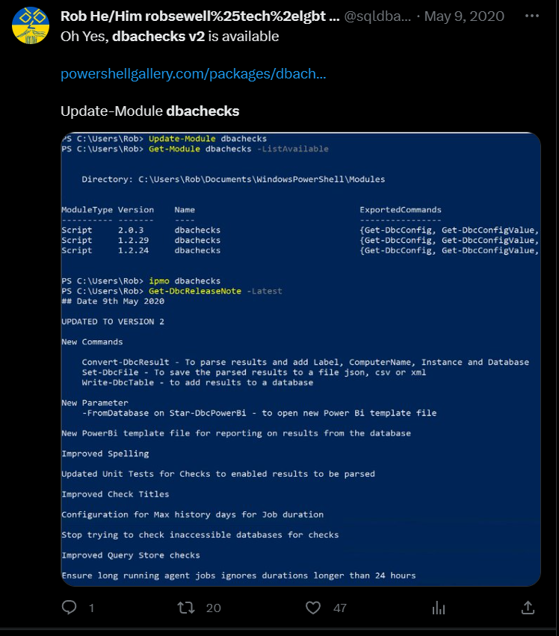

Evolution of dbachecks
2016
2020
Initially, Rob created dbareports to validate and report on SQL estates
dbachecks v2 released enabling conversion of results into PowerShell Objects and database loading
2018
dbachecks v1 released at SQLBits enabling configurable Pester checks using dbatools
Notes:
R

Slide 13

Evolution of dbachecks
2016
2020
Initially, Rob created dbareports to validate and report on SQL estates
dbachecks v2 released enabling conversion of results into PowerShell Objects and database loading
2018
2023
dbachecks v1 released at SQLBits enabling configurable Pester checks using dbatools
dbachecks v3 released. Performance improvements and Pester v5
Notes:
R

Slide 14
Some of our top dbachecks
Instance Connectivity
Check if the instance is connectable, pingable and using the expected authentication method.
Backup Status
Check if backups are being performed and respecting the configured policy.
Database Ownership
Validate that database is owned by the expected login.
Corruption Detection
Ensure all your databases have had a recent CheckDB to avoid corruption issues.
Certificate Expiration
Find certificates about to expire to avoid outages.
There are 140 checks so we couldn’t pick them all!
Notes:
C

Slide 15
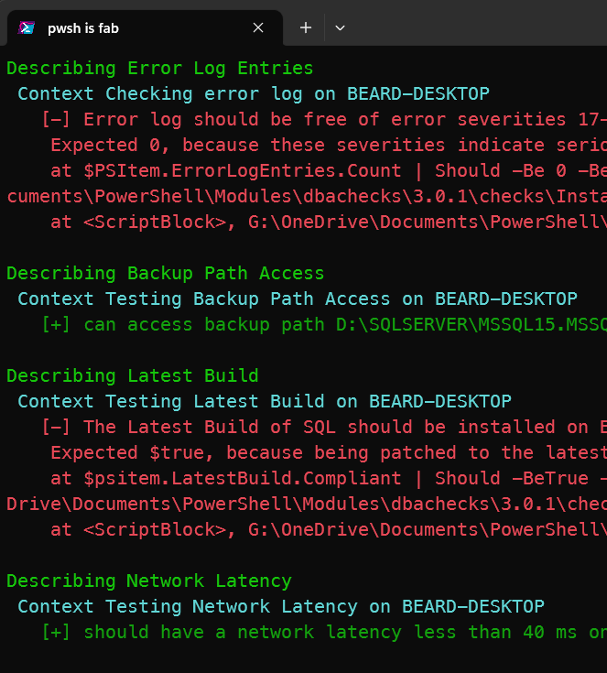
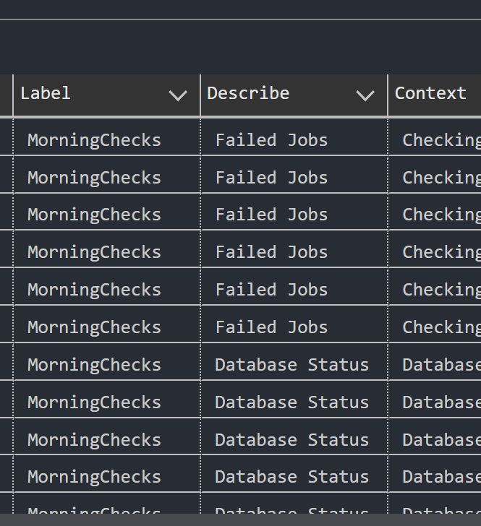

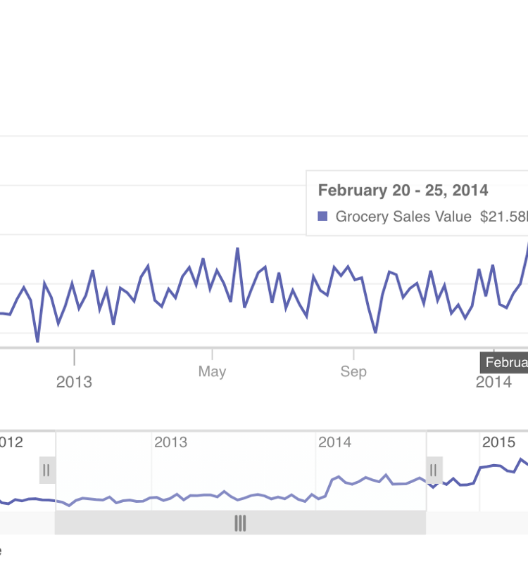
Viewing results
Results in the console
Results stored in SQL Server
PowerBI Report
Standard dbachecks output in the PowerShell console
Push those results straight into a SQL Server Database for safe keeping
Dashboard displaying dbachecks results, trends, and metrics.
Notes:
C

Slide 16



Why Pester v5?
Faster test execution
Improved scalability for large test suites
Enhanced output formatting
Better compatibility for users
Notes:
C

Slide 17




Changes in dbachecks v3
Complete rewrite of dbachecks framework
Direct relationship with new and improved SMO
Standardized checks design
Backwards compatibility with Pester v4
The checks have been completely rewritten to create a framework for improved performance and scalability
New internal functions that optimize SMO calls to build the complete picture of an instance for just the checks you select.
Checks have been rewritten into a standard format. All checks can be skipped individually.
The legacy parameter enables checks to be run with older pester versions.
The complete rewrite of dbachecks using a modular framework positions it for controlled, predictable growth while maintaining compatibility with previous versions.
Notes:
Highlight that by default it will run in legacy mode to not break current processes & scripts R

Slide 18
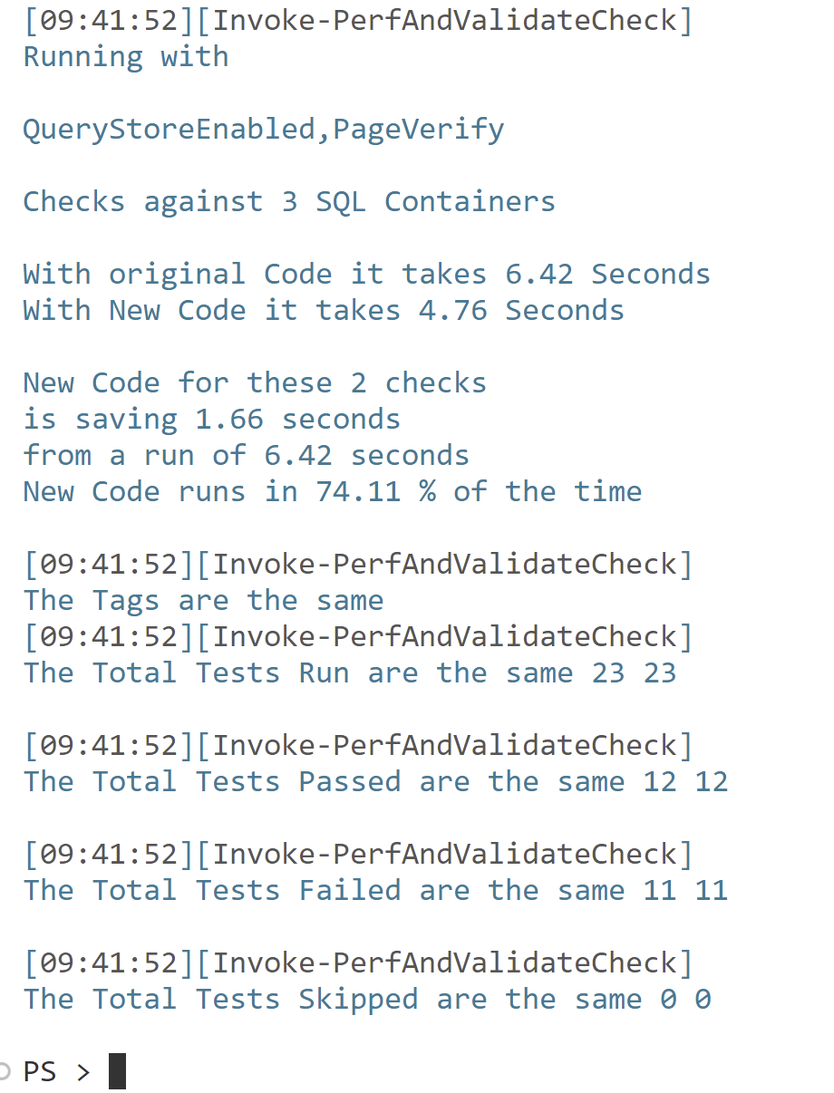
Testing every test
Are we getting the same results?
Is it faster?
Have we found bugs?
Notes:
J

Slide 19

Notes:
Do a demo in a dev container? – ALL of us on Robs Machine Demo cool stuff and the PBI
-
-
-
-

Slide 20


https://eval.datasaturday.no/196204995051292

Slide 21
Feedback please!
https://eval.datasaturday.no/196204995051292

